Slide 1
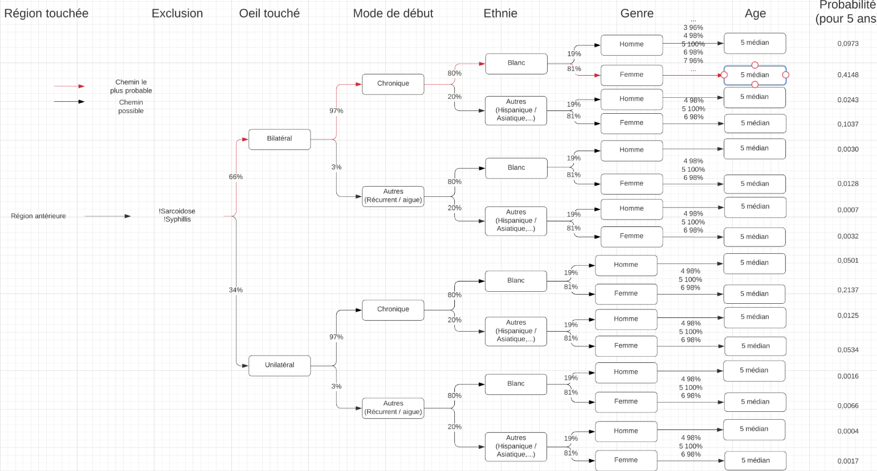
Notes:
https://lucid.app/lucidchart/030fd7a0-3274-44eb-90e9-45e7442bcd32/edit?invitationId=inv_cae65e69-d1a1-424b-94b4-15a752560ceb

